Slide 1
25th ESNCH Conference
Belgrade, 15-17 October 2021
The Normal Mean Values of ONSD and OND and the Issue of Different Cut-off Values.
Application in Neurology and Critical Care Patients
Dr. Andrea Naldi, MD
Department of Neuroscience “Rita Levi Montalcini”, University of Turin, Italy
Neurology Unit, San Giovanni Bosco Hospital, Turin, Italy
andrea.naldi@aslcittaditorino.it

Slide 2
Optic nerve sheath diameter
885 results (ultrasound: 643)
2020
138 (119)
)
2008

Slide 3
Overview – ONSD / OND
ONSD / OND Normal and Cut-off Values
1
4
Conclusions
Confounding and limiting factors
2
3
Clinical Applications

Slide 4
1
ONSD – Normative values
ONSD – estimation of intracranial pressure (ICP)
7–15 mmHg = normal ICP
external ventricular drain
intraparenchymal probe
Intracranial hypotension
Few ultrasound works
No normative values
Normal intracranial pressure
Intracranial hypertension
Many ultrasound studies
Potential normative values
Notes:
; at 20–25 mm Hg, the upper limit of normal, treatment to reduce
Se >15 è definite, oltre 20 si tratta
invasive ICP monitoring
Published guidelines recommend ICP <20−25<20−25 mm Hg in the neurointensive care unit for TBI and other forms of acute brain injury
Spontaneous intracranial hypotension – cerebrospinal fluid leak

Slide 5
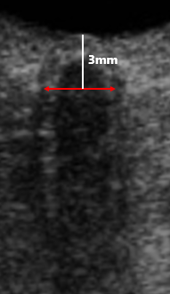
1
ONSD – Normative values
ONSD
Distance between the external borders of the hyperechogenic area surrounding the optic nerve
Metanalysis (Dubourg, 2011; Moretti, 2011)
5.2 mm
5.9 mm
Normal
Intracranial hypertension
5.2 – 5.9 mm
Grey zone
4.78 mm
5.82 mm
(Schroeder, 2020) Metanalysis (Montorfano, 2021)

Slide 6
2
ONSD – Confounding and limiting factors
ONSD borders
Averaging / maximum values
(eyes asymmetry)
Measurements method
Different ultrasound devices and settings
Ultrasound machine
Execution technique
Age - Sex
Ethnicity
Body mass index
...
Axial / coronal measurements
Individuals variability
Number of measurements
HETEROGENEITY

Slide 7
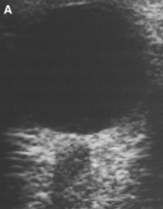
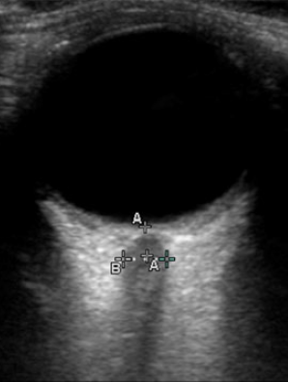
Ultrasound devices
2
ONSD – Confounding and limiting factors
2021
2011
Moretti (2011) - DOI: 10.1111/j.1399-6576.2011.02432.x
Dubourg (2011) - DOI: 10.1007/s00134-011-2224-2

Slide 8
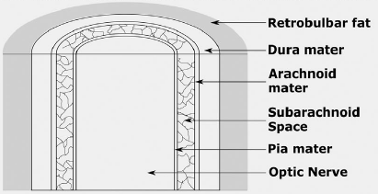
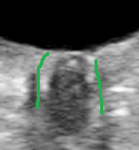
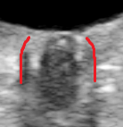
ONSD borders
2
ONSD – Confounding and limiting factors
<< ONSDi >>
internal
<< ONSDe >>
external
ONSD
Distance between the external borders of the hyperechogenic area surrounding the optic nerve
Stevens F. (2021), doi: 10.1111/jon.12906

Slide 9
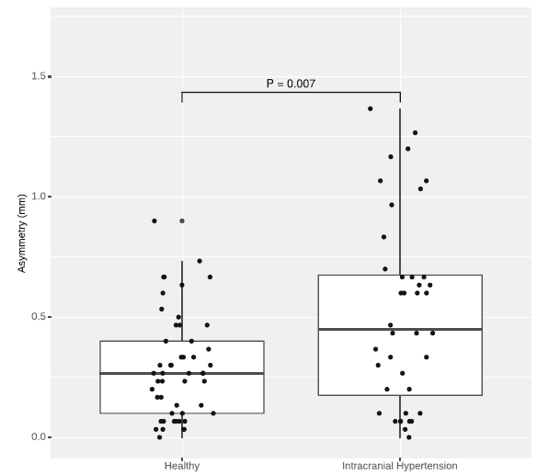
Asymmetry
2
ONSD – Confounding and limiting factors
Asymmetry of ONSD values between eyes
(>> in pathological subjects)
Consider the different inter-ocular enlargement
Asymmetry between eyes
Raised ICP
Binocular ONSD
measurements
Maximum ONSD
?
Intracranial hypertension
Healthy
Naldi A (2020) - doi: 10.1007/s10072-019-04076-y

Slide 10
2
ONSD – Confounding and limiting factors
How reliable are the ONSD normal and cut-off values?
MOSTLY RELIABLE
Clarify unsolved questions
Standardize the method
PROTOCOLS
Devices and settings
“Unique” ONSD borders
Ultrasonographic planes
Number of measurements
Homogeneity of studies
Reproducibility of results
Wide consensus and validation
Automatic measurements
Meiburger, 2020
Stevens, 2021
Gerber, 2017
Soroushmehr, 2019

Slide 11
2
ONSD – Confounding and limiting factors
Do we need a cut-off value for intracranial hypertension?
Intracranial pressure
Dynamic process
Many factors involved
Clinical evaluation
DIAGNOSIS
and
MONITORING
Radiology
Invasive methods
Transorbital sonography

Slide 12
3
ONSD – Clinical Applications
DIAGNOSIS
MONITORING
Intracranial hypertension
Intracranial hypotension
Single evaluation
Diagnosis confirmation
Addressing the diagnosis
Serial evaluations
Dynamic
Predicting role
Cut-off value
Reconsider cut-off value
Suspected raised ICP
Basal value
Decreasing values
Increasing values
Improvement
Deterioration

Slide 13
3
ONSD – Clinical Applications
DIAGNOSIS
MONITORING
NEUROLOGICAL SETTINGS
Vascular pathology
Ischemic stroke
Malignant MCA infarct (predictor of deterioration and outcome)
Hemorrhagic stroke
Hematoma expansion and outcome
Idiopathic Intracranial hypertension
Predictor of outcome; treatments effectiveness
Hydrocephalus
Patients selection for shunt intervention; predictor of outcome
Spontaneous intracranial hypotension
Effects of surgical treatments
PRES
Acute mountain sickness
Pathogenesis; outcome
Meningitis / Encephalitis
Optic neuritis
Pathogenesis; treatments effectiveness

Slide 14
3
ONSD – Clinical Applications
DIAGNOSIS
MONITORING
“NOT” NEUROLOGICAL SETTINGS
Traumatic brain injury
Predictor of outcome and mortality
Cardiac arrest / Coma / Brain death
Predictor of outcome and mortality
Surgical / Intraoperative
Laparoscopic surgery
Abdominal aortic aneurysm repair
Carotid endoarterectomy
Hemicraniectomy
...
Predictor of outcome
Pregnancy
Non-invasive assessment
Predictor of pre-eclampsia and eclampsia
Treatments effectiveness
Lochner P (2019) - doi: 10.1007/s10072-019-04015-x

Slide 15
1
OND – Normative values
OND
optic nerve pathologies
neuroinflammation
3.08 mm
2.8 mm
3.2 mm
1.8 mm
4.0 mm

Slide 16
2
ONSD – Confounding and limiting factors
OND
Distance between the internal borders of the hyperechogenic area sorrounding the optic nerve
3 mm
No methodological differences for OND measurements
Low heterogeneity across studies
Reliability of values

Slide 17
3
OND – Clinical Applications
FEW WORKS AVAILABLE
Optic neuritis
Variable results
Multiple sclerosis
Optic nerve atrophy
Monitoring
Effects of treatments
NO CUT-OFF VALUE
FOR OPTIC NERVE ATROPHY
Neurodegenerative disorders?
Other optic nerve pathologies?
FUTURE DIRECTIONS

Slide 18
4
Conclusion
ONSD
OND
Wide application of ONSD ultrasonography
High heterogeneity across the studies
No clear cut-off value for estimating intracranial hypertension
Standardization of the method and protocols are required
Diagnosis and monitoring
Few studies for OND ultrasonography
Low heterogeneity across the studies
No clear cut-off value for optic nerve atrophy
POTENTIAL!

Slide 19
Thank you for your attention
Turin - Italy
andrea.naldi@aslcittaditorino.it

